Slide 1
CART Work in Regression
Sri Harsha A

Slide 2
CART Work in Regression
Decision Trees is the non-parametric supervised learning approach
For regression trees, two common impurity measures are:
Least squares
This method is similar to minimizing least squares in a linear model. Splits are chosen to minimize the residual sum of squares between the observation and the mean in each node
Least absolute deviations
This method minimizes the mean absolute deviation from the median within a node

Slide 3
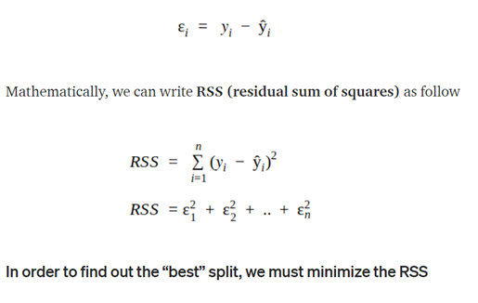
How Does CART Work in Regression with one predictor?
CART in classification cases uses Gini Impurity in the process of splitting the dataset into a decision tree
On the other hand CART in regression cases uses least squares, intuitively splits are chosen to minimize the residual sum of squares between the observation and the mean in each node

Slide 4
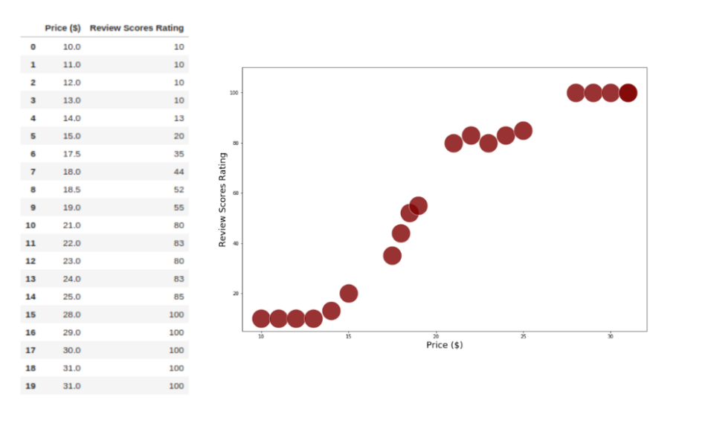
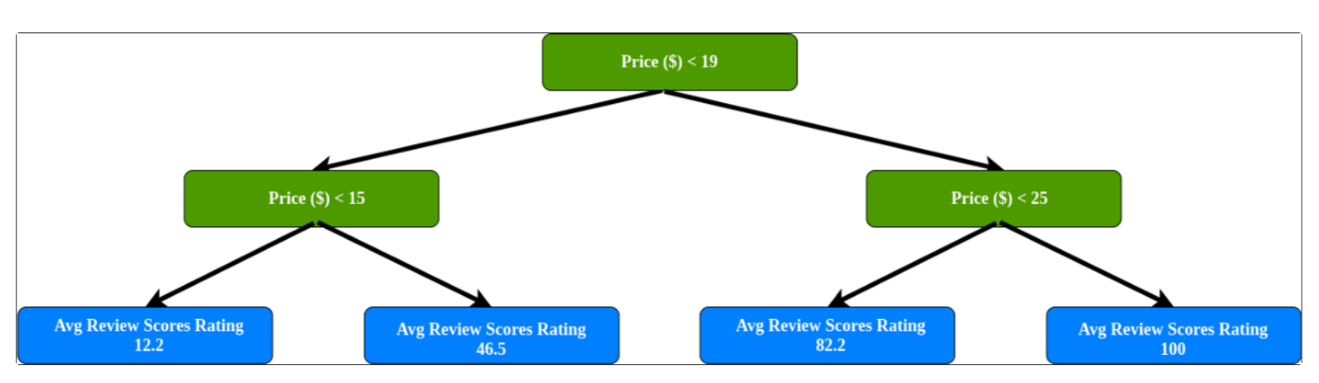
Intuition

Slide 5
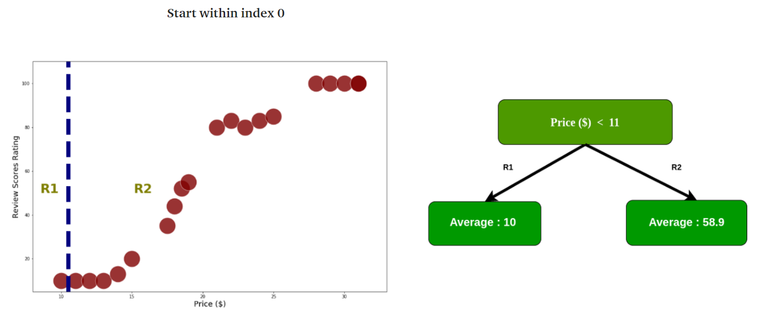
How does CART process the splitting of the dataset
As mentioned before, In order to find out the “best” split, we must minimize the RSS. first, we calculate RSS by split into two regions, start with index 0

Slide 6
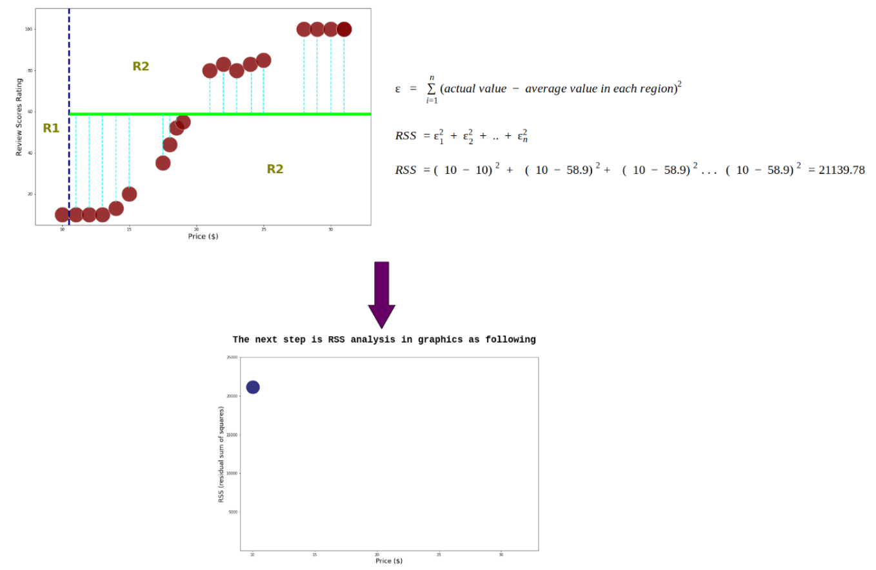
How does CART process the splitting of the dataset (predictor =1)

Slide 7
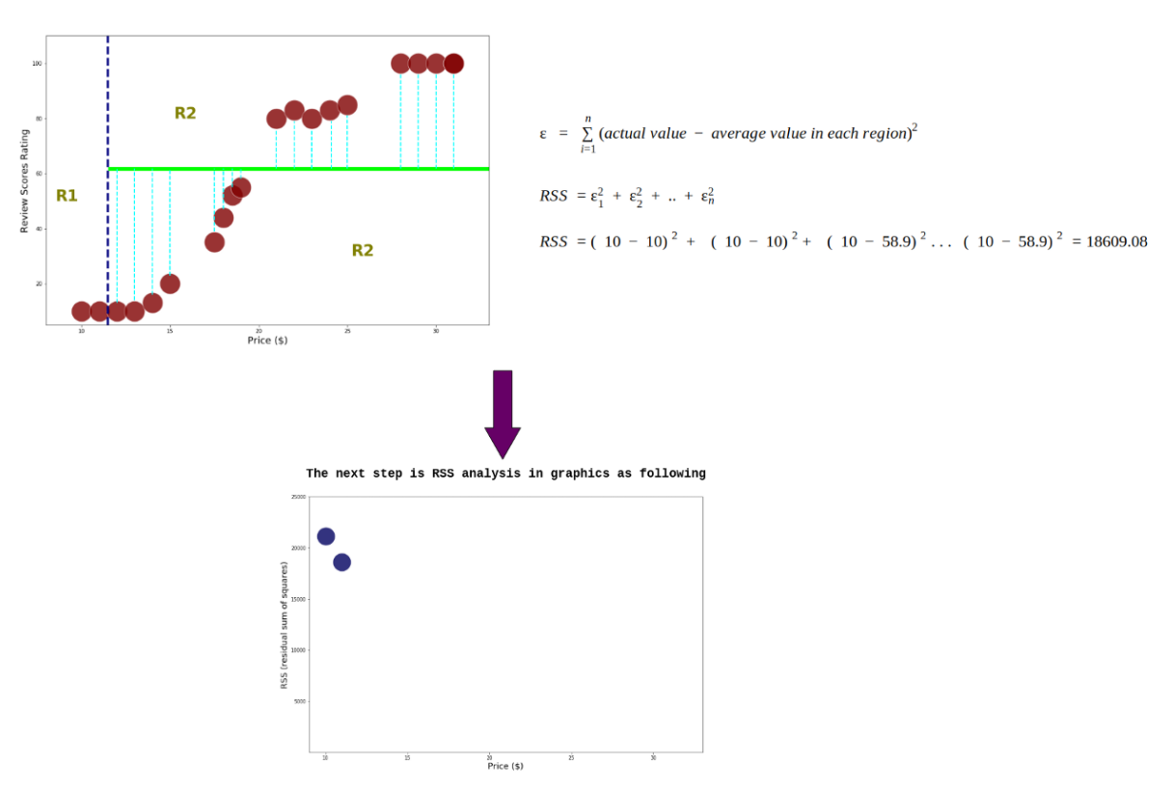
Start within index 1

Slide 8
Start within index 1

Slide 9
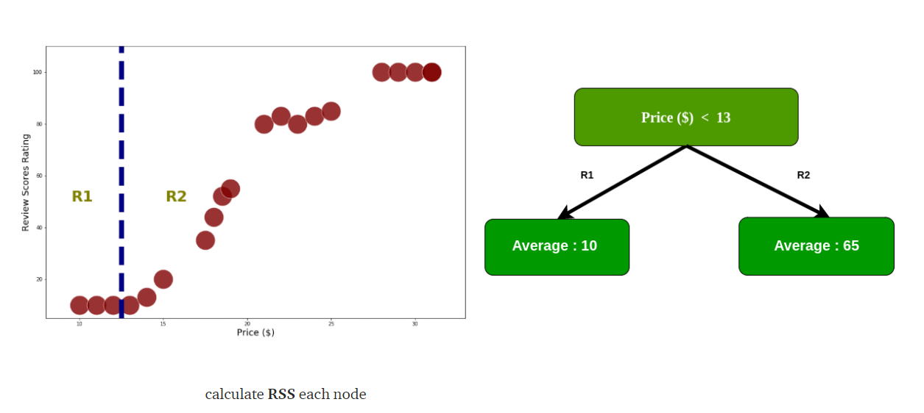
Start within index 2

Slide 10
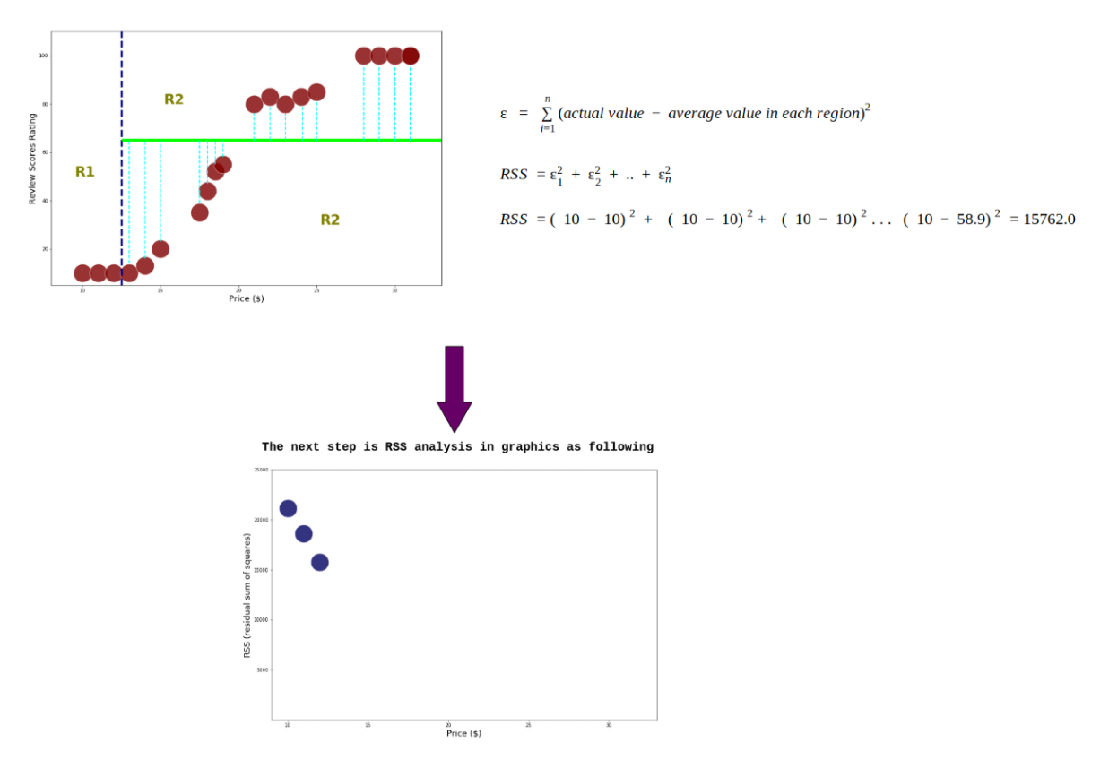
Start within index 2
This process continues until the calculation of RSS in the last index

Slide 11
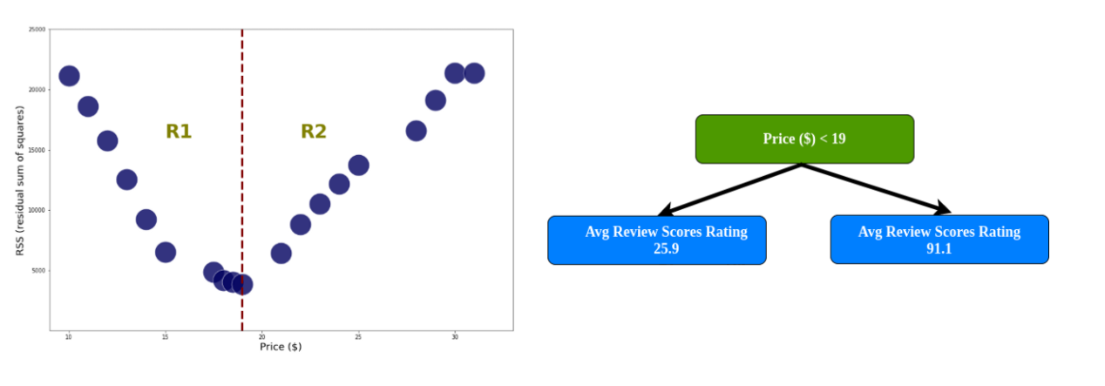
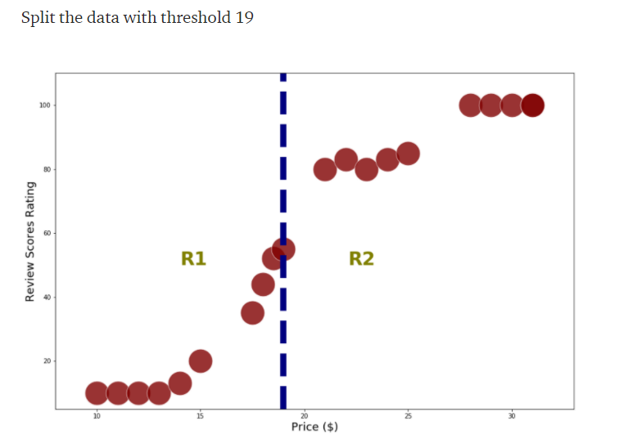
Last Index
Price with threshold 19 has a smallest RSS, in R1 there are 10 data within price < 19, so we’ll split the data in R1.
In order to avoid overfitting, we define the minimum data for each region >= 6.
If the region has less than 6 data, the split process in that region stops.

Slide 12
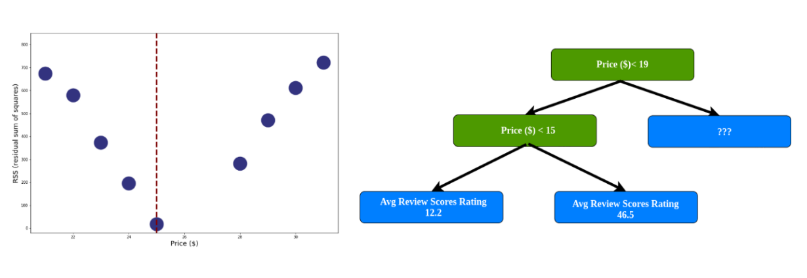
Calculate RSS in R1
Do the same thing on the right branch, so the end result of a tree in this case is

Slide 13
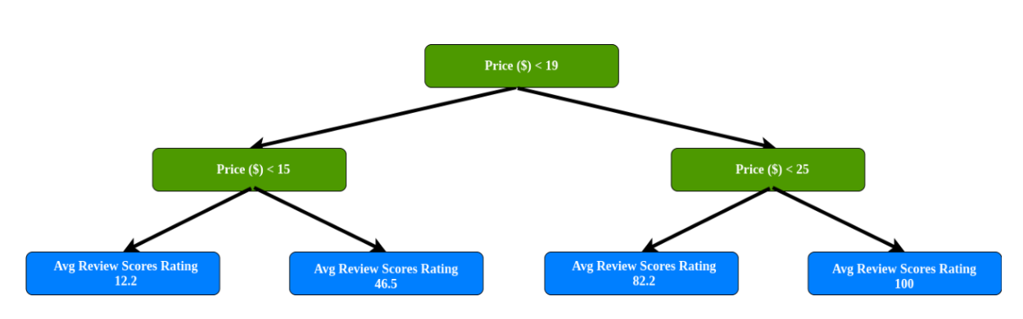
Calculate RSS in R2

Slide 14
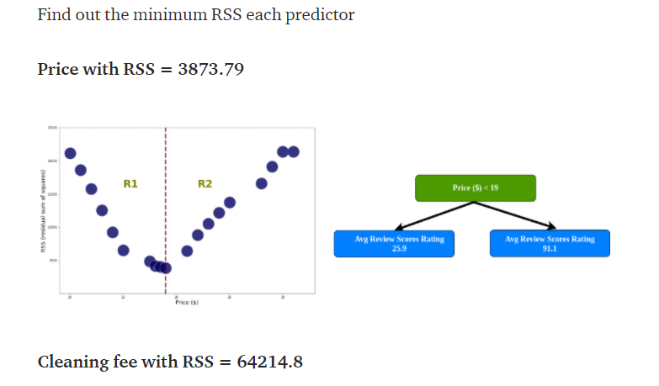
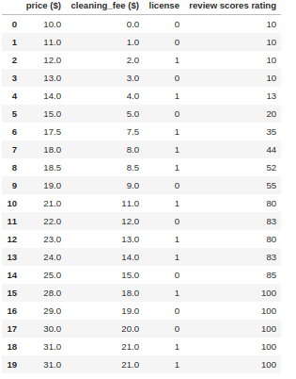
How does CART process the splitting of the dataset (predictor > 1)

Slide 15
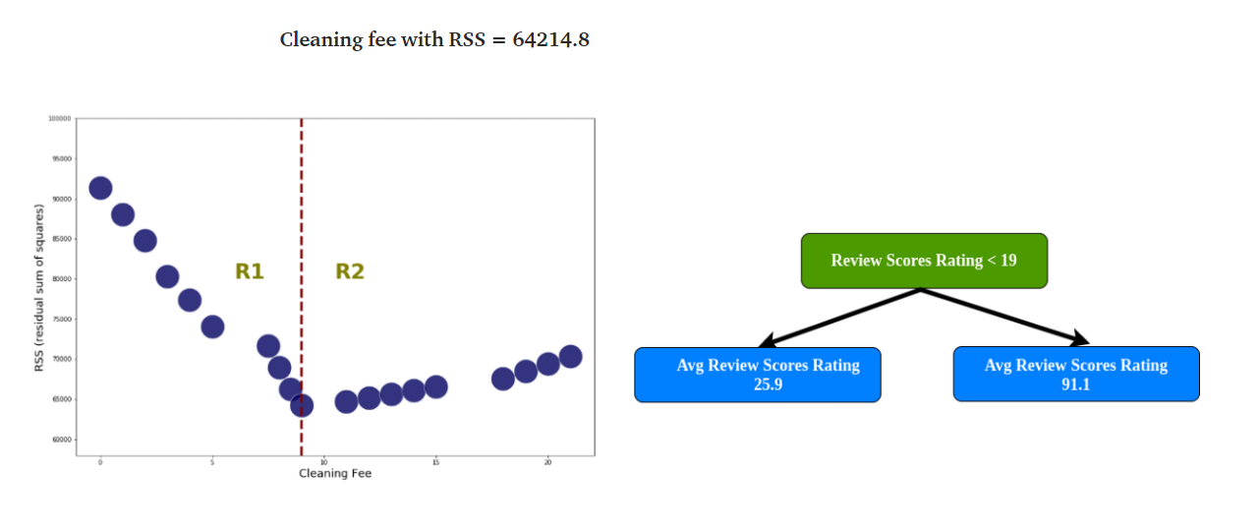
How does CART process the splitting of the dataset (predictor > 1)

Slide 16
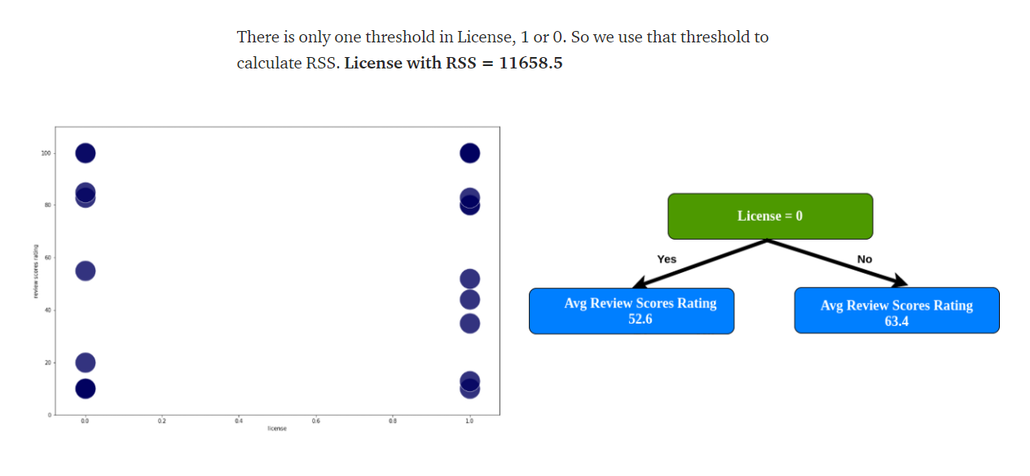
How does CART process the splitting of the dataset (predictor > 1)
We already have RSS every predictor, compare RSS for each predictor, and find the lowest RSS value. If we analyze, License has the lowest value so it becomes root.

Slide 17
References
https://towardsdatascience.com/decision-trees-d07e0f420175
https://machinelearningmastery.com/classification-and-regression-trees-for-machine-learning/
https://arifromadhan19.medium.com/regrssion-in-decision-tree-a-step-by-step-cart-classification-and-regression-tree-196c6ac9711e

